Slide 1
Com681 Data Analytics Assignment 1
David Fodor B00796884 fodor-d@ulster.ac.uk

Slide 2
introduction to the domain
Chosen dataset: Deaths registered by single year of age, UK (2019 edition)
Source: Office for National Statistics
Death statistics gathered from civil registration
Figures show death registration count per calendar year
Deaths occurring in England, Wales, Scotland, and Northern Ireland are included, regardless of usual residence

Slide 3
objectives of this data analysis
To see if there is a pattern, regarding the changing in the yearly average age of registered deaths, across the span of years
To ensure that if there is a pattern, it is substantial enough
To try and predict values which are not included in the source dataset

Slide 4
details related to data preparation/cleaning/wrangling
The downloaded .xls file consisted of multiple tables
Deleted everything except for the ‘Male death registrations by single year of age, United Kingdom, 1974-2019’ table
Removed rows that were irrelevant to the reading of this dataset, like table title, or hyperlinks to other tables or websites
Removed the rows where the Age column’s value was ‘105+’ and ‘Not Stated’, because these are not precise enough to calculate with
Removed the ‘Total’ row, because it took the aforementioned rows into consideration, so it had to be recalculated

Slide 5
methods used for data analysis
The data analysis was done in Rstudio
Main steps:
Reading from Excel file
Catering for missing values
Checking the structure of the data
Drawing a box plot, determining if it is a normal distribution, checking outliers
Plotting a graph
Building a simple linear regression model
Analysing the correlation of the two vectors
Prediction testing
Predicting new values

Slide 6
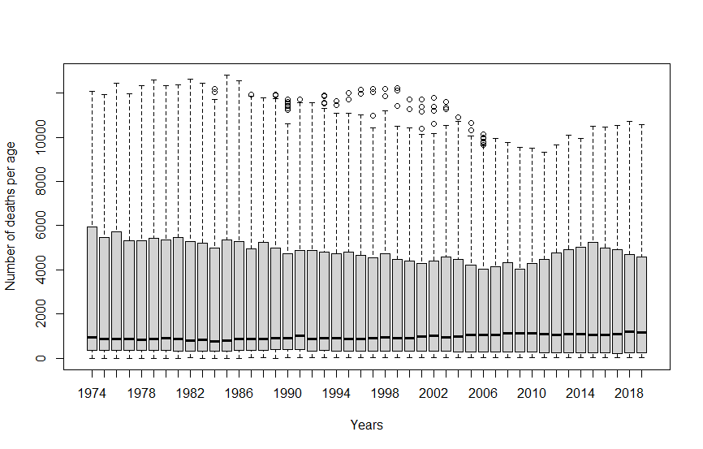
results and visualizations
Median: ~1000
IQR: ~0-5000
Outliers: ~10k-12k
Conclusion: There is an age group in which deaths occur more frequently

Slide 7
results and visualizations
Average life expectancy in each year
- | 1980: 68.26978 | 1990: 70.31722 | 2000: 72.21522 | 2010: 73.69151
- | 1981: 68.56901 | 1991: 70.65386 | 2001: 72.33019 | 2011: 73.90188
- | 1982: 68.87994 | 1992: 70.91747 | 2002: 72.49641 | 2012: 74.45316
- | 1983: 69.12526 | 1993: 71.34706 | 2003: 72.73246 | 2013: 74.61471
1974: 66.95715 | 1984: 69.25281 | 1994: 71.33560 | 2004: 72.72337 | 2014: 74.68451
1975: 67.28980 | 1985: 69.68174 | 1995: 71.58620 | 2005: 72.88048 | 2015: 75.04611
1976: 67.69767 | 1986: 69.69161 | 1996: 71.72033 | 2006: 72.87797 | 2016: 74.96411
1977: 67.71022 | 1987: 69.71470 | 1997: 71.86916 | 2007: 73.08300 | 2017: 75.25503
1978: 67.86826 | 1988: 69.89913 | 1998: 71.92024 | 2008: 73.26241 | 2018: 75.23996
1979: 68.07677 | 1989: 70.35347 | 1999: 72.14147 | 2009: 73.37699 | 2019: 75.33033

Slide 8
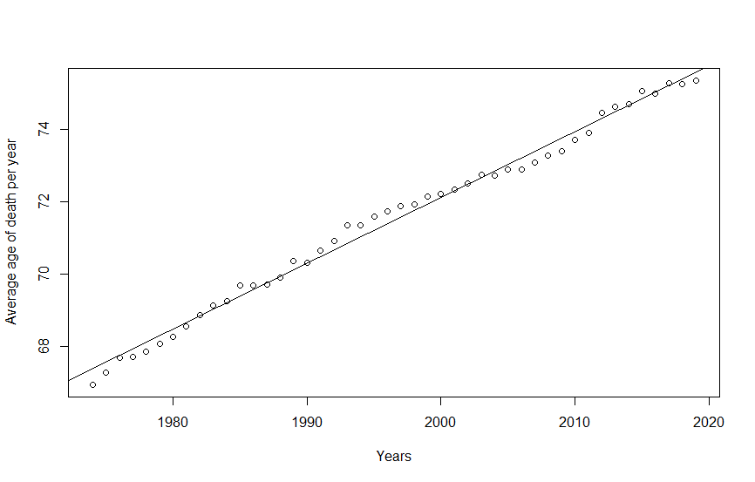
results and visualizations
Intercept: -291.4526
Slope: 0.1818
Pearson correlation coefficient: 0.995775
P-value: < 2.2e-16
Predicted average life expectancy by 2077: 86 years
Average life expectancy is rising by ~66 days each year

Slide 9
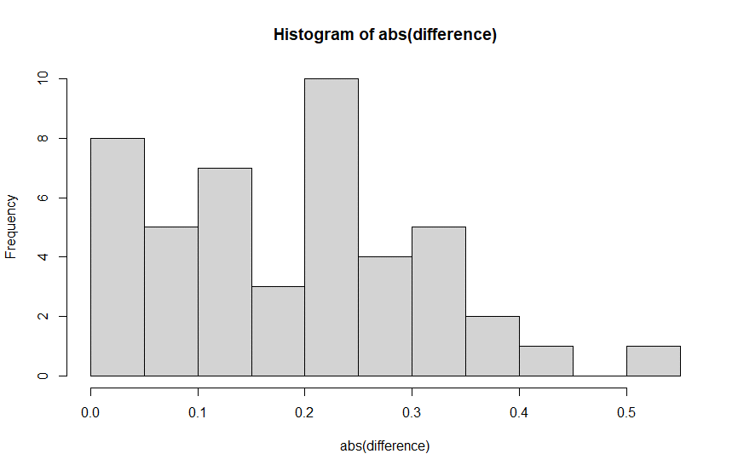
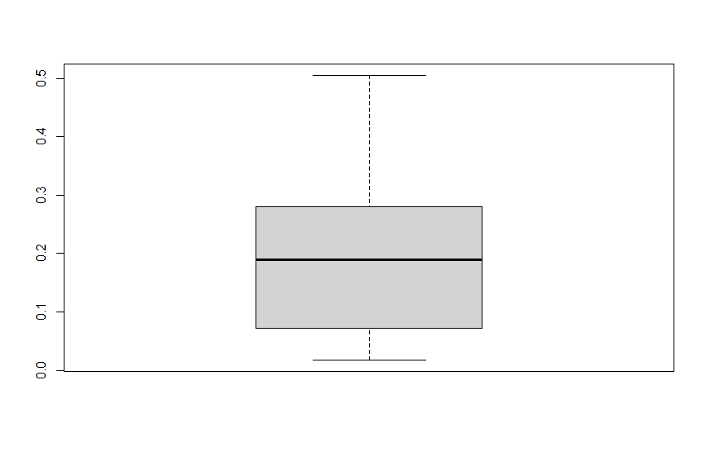
results and visualizations

Slide 10
discussions/interpretations/conclusions
There is a nearly perfect positive correlation between life expectancy, and the year we are discussing
We can very fittingly plot the points on a straight line, in the context of the timespan we are covering (1974 - 2019)
Predictions might not be accurate too far into the future or past
“Life expectancy” is an oversimplification, referring to the average of all the deaths registered in a given year, and it should be treated as such

Slide 11
references
Office for National Statistics. (2019). Deaths registered by single year of age, UK [online] Available at: https://www.ons.gov.uk/peoplepopulationandcommunity/birthsdeathsandmarriages/deaths/datasets/deathregistrationssummarytablesenglandandwalesdeathsbysingleyearofagetables [Accessed 03 Nov. 2021].
DataFlair. (2021). Introduction to Hypothesis Testing in R – Learn every concept from Scratch! [online] Available at: https://data-flair.training/blogs/hypothesis-testing-in-r/ [Accessed 05 Dec. 2021].
DataMentor. (2021). R for Loop [online] Available at: https://www.datamentor.io/r-programming/for-loop/ [Accessed 05 Dec. 2021].
StackOverflow. (2017). Convert all columns to characters in a data.frame [online] Available at: https://stackoverflow.com/questions/43789278/convert-all-columns-to-characters-in-a-data-frame/48468323#48468323 [Accessed 05 Dec. 2021].

Slide 12
references
StackOverflow. (2015). How to simply multiply two columns of a dataframe? [online] Available at: https://stackoverflow.com/questions/31824863/how-to-simply-multiply-two-columns-of-a-dataframe/31825400 [Accessed 06 Dec. 2021].
Rebecca Bevans. (2020). A step-by-step guide to linear regression in R [online] Available at: https://www.scribbr.com/statistics/linear-regression-in-r/ [Accessed 07 Dec. 2021].
Top Tip Bio. (2021). How To Perform A Pearson Correlation Test In R [online] Available at: https://toptipbio.com/pearson-correlation-test-r/ [Accessed 07 Dec. 2021].
DataScience+. (2015). How to Deal with Missing Values in R [online] Available at: https://datascienceplus.com/missing-values-in-r/ [Accessed 07 Dec. 2021].

